Slide 1


User persona
Max Meiners
214936

Slide 2
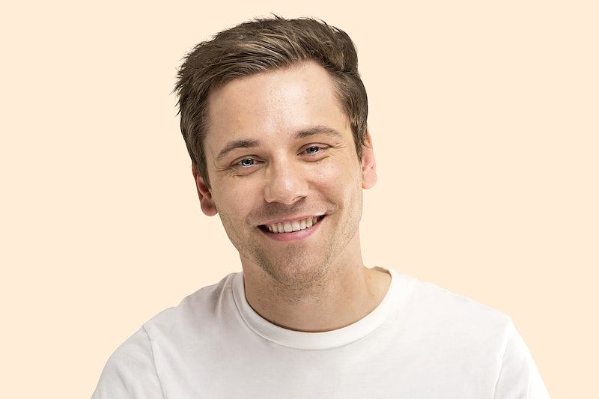
Personal background
Name: Harm Flora
Age: 41
Status:
Married father with 2 children
Education:
Masters in wildlife biology
User environment
Location:
Anywhere outside
Devices:
Binoculars
GPS devices
Camera traps
Environmental sensors
End goals
Works towards preserving species that are at risk of extinction due to habitat loss, poaching, or other factors.
Professional background
Occupation:
Full-time at a zoo
Income:
$64,650 per year
Psychographics
Passion for nature
Strong environmental ethics
Intellectual curiosity
Dedication to conservation
Ability to work independently
Love for adventure
Scenario
A wildlife biologist named John goes on a safari to monitor the lion population in an African national park. He spots a group of vultures circling above a buffalo carcass and uses his binoculars to locate the lions feeding on it. He alerts the park rangers and spends the rest of the day observing the lions’ behaviour, noting their interactions and hunting techniques. John feels satisfied with his research and returns to camp at sunset.

